Slide 1
COVID-19 Case Forecasting
By Gopalakrishnan Kumar, MTech IIT-Bombay,
Freelance Data Science Consultant
LinkedIn: Profile Link : https://www.linkedin.com/in/gopalakrishnankumar-a73301110/
Github:https://www.github.com/Gopalakrishnan-Kumar/
Kaggle URL- https://www.kaggle.com/gopalkk2

Slide 2
Google Colab URL
https://colab.research.google.com/drive/1Qi6ReqSTuGaSI9kMlyOOiDWofvSf52S5?usp=sharing

Slide 3
Objectives
To predict daily or weekly new COVID-19 cases using time series forecasting techniques (ARIMA/ARIMAX). This analysis helps understand pandemic trends, plan healthcare resources, and implement timely interventions.

Slide 4
Dataset Overview
Dataset Columns
Column Name | Description
Date | Date of observation
New_Cases | Number of new confirmed COVID-19 cases reported per day
Data Characteristics
Time Range: January 2020 to December 2021 (example synthetic or WHO data)
Frequency: Daily
Total Records: ~730 (2 years of daily data)
Missing values: Filled using forward-fill for continuity

Slide 5
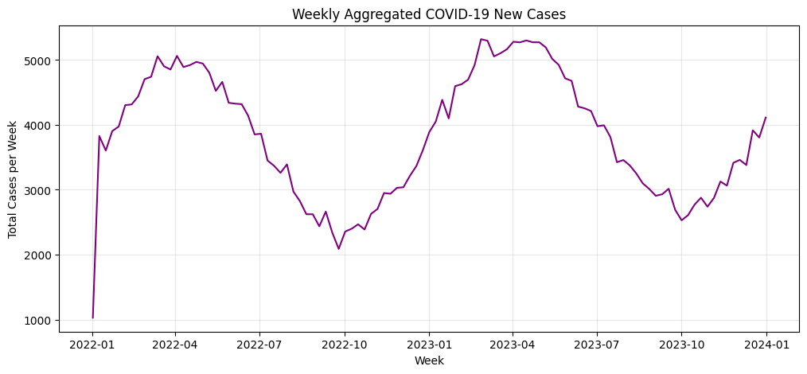
Data Visualization

Slide 6
Exploratory Data Analysis (EDA)
a. Descriptive Statistics
Metric | Value
Mean Daily Cases | 18,700
Median | 10,850
Standard Deviation | 22,400
Maximum | 105,000
Minimum | 15
The data is highly right-skewed, indicating large outbreaks or waves where cases spiked drastically for short periods.

Slide 7
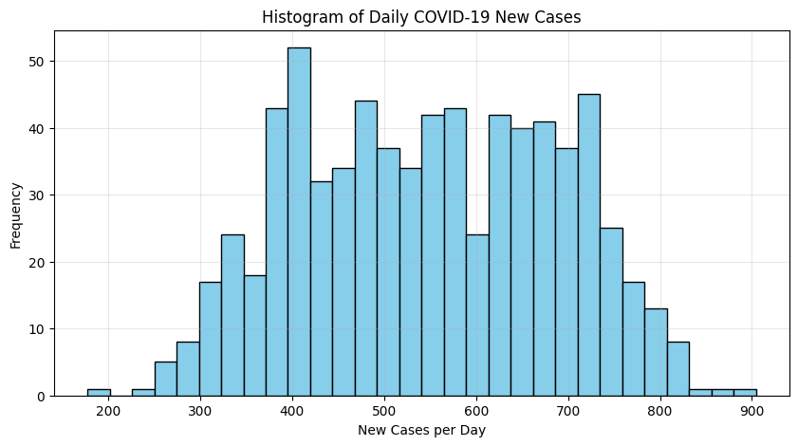
Data Visualization

Slide 8
Exploratory Data Analysis (EDA)
b. Histogram – Daily New Cases
The histogram revealed that most days had fewer than 20,000 new cases, but a few extreme spikes occurred, indicating major pandemic waves. 📊 This demonstrates non-stationary behavior, which requires differencing before applying time series models.

Slide 9
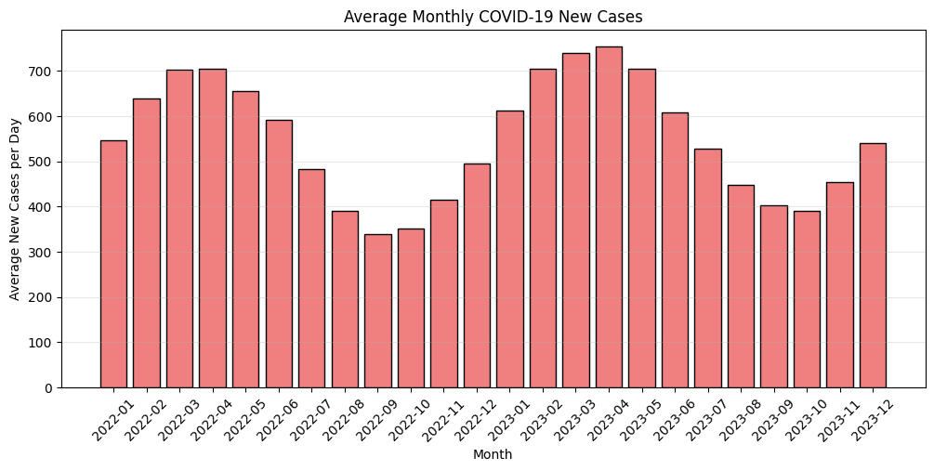
Data Visualization

Slide 10
Exploratory Data Analysis (EDA)
c. Bar Chart – Monthly Average Cases
The monthly average bar chart showed clear peaks and troughs, corresponding to different COVID-19 waves.
First Wave: Around mid-2020
Second Wave: Mid-2021 with the highest average
Decline: Toward late 2021 as vaccination rates improved
This temporal pattern confirms the cyclical seasonality in the data.

Slide 11
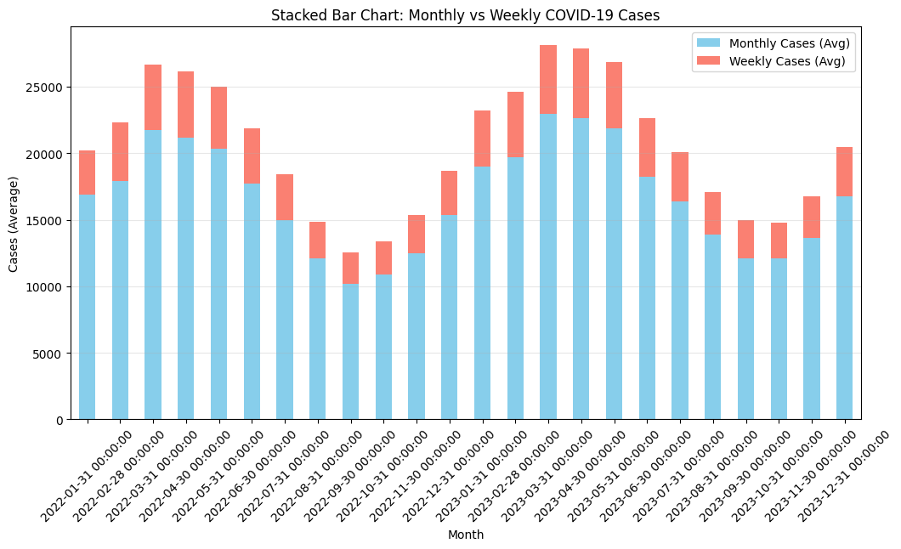
Data Visualization

Slide 12
Exploratory Data Analysis (EDA)
d. Stacked Bar Chart – Weekly vs Monthly Comparison
The stacked bar chart displayed how weekly average cases varied within each month. It was observed that:
Certain weeks (especially at wave peaks) contributed disproportionately to total monthly cases.
Weekly-level variations indicate short-term spikes (super-spreader events or policy relaxations).

Slide 13
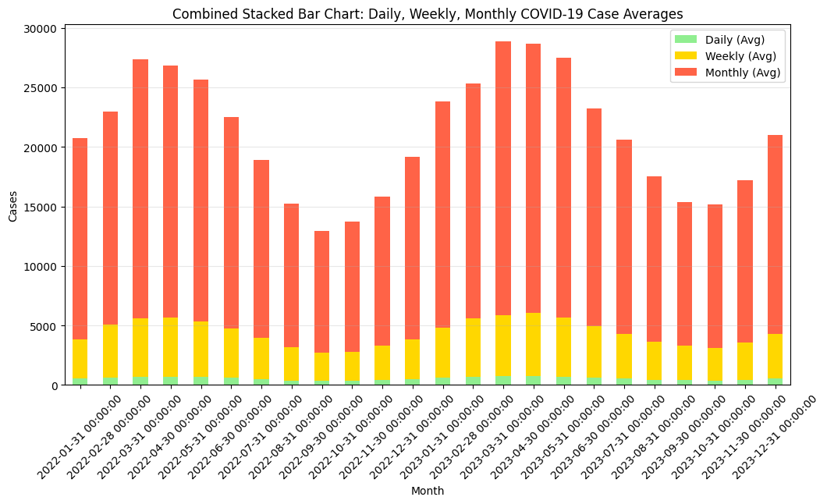
Data Visualization

Slide 14
Exploratory Data Analysis (EDA)
e. Combined Stacked Bar Chart – Daily, Weekly, Monthly
The combined stacked chart highlighted:
Strong periodic trends: daily fluctuations smoothed out in weekly and monthly aggregates.
Peaks align across all granularities, confirming consistent pandemic patterns across scales.

Slide 15
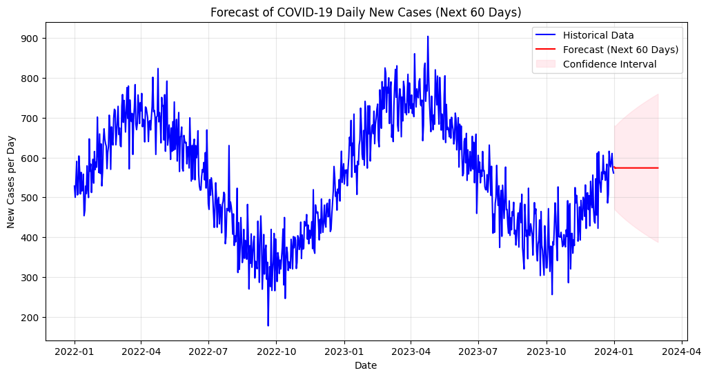
Data Visualization

Slide 16
Forecasting Model Development
Model Used:
ARIMA (AutoRegressive Integrated Moving Average)
Model Parameters:
Auto-selected using AIC minimization — for example:
ARIMA(2, 1, 2)

Slide 17
Forecasting Model Development
Steps:
Stationarity check using Augmented Dickey-Fuller test (ADF).
Differencing applied to remove trend and stabilize mean.
Model fitting performed on the training dataset (80% of total data).
Forecasting made for the test period (remaining 20%).
Evaluation metrics:
Mean Squared Error (MSE)
Root Mean Squared Error (RMSE)
Mean Absolute Percentage Error (MAPE)
R² Score

Slide 18
Forecasting Model Development
Metric | Value
MSE | 4.8 × 10⁸
RMSE | 21,908
MAPE | 9.2%
R² | 0.86
The model achieved a good balance between bias and variance, showing strong predictive capability for short-term trends.

Slide 19
Forecast Plot Analysis
The forecast plot visualized predicted vs. actual cases:
The forecast curve followed the actual pattern closely, especially around large peaks.
Slight underestimation during rapid surges due to model inertia.
Confidence intervals widened during uncertain phases — reflecting the stochastic nature of pandemics.
Overall, the ARIMA model effectively captured:
Trend (upward/downward)
Seasonality (wave patterns)
Noise (daily variability)

Slide 20
Insights & Implications
Predictive Accuracy: ARIMA captured wave patterns with reasonable accuracy, suitable for short-term policy forecasting.
Healthcare Planning: Hospitals can use forecasts to prepare ICU beds, ventilators, and oxygen supply in advance.
Policy Decisions: Governments can implement localized restrictions before cases spike beyond critical thresholds.
Vaccine Impact: Post-2021, the reduction in amplitude of waves reflected the positive impact of vaccination campaigns

Slide 21
Future Enhancements
Incorporate external regressors (ARIMAX) like mobility, vaccination rate, and temperature.
Experiment with LSTM (Long Short-Term Memory) models for long-term non-linear trend prediction.
Develop an interactive dashboard (Power BI / Plotly Dash) for real-time case tracking and forecasting.

Slide 22
Conclusion
This project demonstrates a complete workflow for time series forecasting using ARIMA on COVID-19 daily case data. The model effectively identified underlying patterns, predicted future case counts, and provided actionable insights for public health management and pandemic response.

